Slide 1
0-1 Knapsack Problem:
Recursive with Memoization
vs.
Bottom-Up Dynamic Programming
Larkin Wisdom, Miguel Gomez, Nicholas Pellegrino

Slide 2

Today is my birthday (April 29)!
-Nick
pixabay.com
Notes:
Nick

Slide 3
Problem & Solutions

Slide 4
The 0-1 Knapsack Problem
Key: N = number of items C = capacity of knapsack
Given N items with associated weights and values, and a knapsack with capacity C, which items do we include in the knapsack to maximize profit? Items cannot be divided fractionally.
w = 10, p = $4
w = 15, p = $7
?
C = 30
w = 20, p = $9
N = 3
Notes:
Larkin

Slide 5
Solution #1: Recursive with Memoization
getSolution(table knapsack, int i, int c):
if knapsack[i][c] ≥ 0:
return knapsack[i][c]
else if current item will exceed weight cap:
solution := getSolution(knapsack, i-1, c)
knapsack[i][c] = solution // save solution in table for future use
return knapsack[i][c]
else:
// choose whether or not to add the current item
solution := max(getSolution(knapsack, i-1, c), getSolution(knapsack, i-1, c-wi)+pi)
knapsack[i][c] := solution
return solution
Notes:
Larkin

Slide 6
Solution #1: Recursive with Memoization
Step #1 →
i=3, c=3
← Step #19
(store 6 in table)
c=0 c=1 c=2 c=3
Items (N=3, C=3):
1 : Weight=1, Profit=1
2: Weight=1, Profit=2
3: Weight=1, Profit=3
i=0
i=1
i=2
i=3
0 | 0 | 0 | 0
0 | 1 | 1 | 1
0 | -1 | 3 | 3
0 | -1 | -1 | 6
solution(i=2, c=3)
solution(i=2,c=1)
← Step #12
(store 3 in table)
← Step #9
(store 3 in table)
Step #2 -->
Step #11 -->
i=2, c=3
i=2, c=2
← Step #7
← Step #10
(store 1 in table)
← Step #13
Step #3 →
i=1, c=3
i=1, c=2
Step #6 →
(store 1 in table)
i=1, c=2
i=1, c=1
Retrieve 1 from [i=1, c=2]
Step #4 →
Step #5 →
i = item considered c = current capacity
i=0, c=1
i=0, c=0
i=0, c=3
i=0, c=2
i=0, c=2
i=0, c=1
← Step #16
Notes:
Larkin
call Solution(i == 3, c== 3)
check if solution is in table
no-> compute
not case 1 (since wi < c)
yes case 2:
solution to c== 3, i == 3 is max(solution(i==2, c==3), solution(i==2, c==3-wi)) where wi is the weight of the 3rd item
we need to recurse here 2 times to compute the solutions to both subproblems
by the time the first recursion is completed, we have stored the value of Solution(i==2, c==1) for the second recursion to use
we calculate the max and then find the solution to (i==3, c==3)

Slide 7
Solution #2: Bottom-Up Dynamic Programming
Initialize first column and first row of table to all 0s
for i ∊ [0, n]:
for c ∊ [1, C]:
if wi <= c:
if P[i-1, c-wi] + pi > P[i-1, c]: // case 1
P[i,c] := P[i-1, c]
else:
P[i,c] := P[i-1, c] // case 2
else:
P[i,c] = P[i-1, c] // case 3
Notes:
Larkin

Slide 8
Solution #2: Bottom-Up Dynamic Programming
c=0 c=1 c=2 c=3 c=4 c=5
For each item i of weight w and profit p & each size c:
i=0
i=1
i=2
i=3
i=4
i=5
If w > c
If w ≤ c
0 | 0 | 0 | 0 | 0 | 0
0 | 0 | 0 | 0 | 0 | 0
0 | 0 | 0 | 0 | 40 | 40
0 | 0 | 0 | 0 | 40 | 40
0 | 0 | 0 | 0 | 40 | 40
0 | 0 | 0 | 95 | 95 | 95
[i-1, c]
[i, c]
[i-1, C-w] | ? | [i-1, C]
[i, C-w] | ? | [i, C]
Notes:
Larkin

Slide 9
Algorithm Analysis (1/2)
Recursive w/Memo. Bottom-Up Dynamic Prog.
TIME COMPLEXITY
Θ (N * C)
CALCULATION
We only go through unique cases at most once due to the memoization
There are N* C cases
TIME COMPLEXITY
Θ (N * C)
CALCULATION
We do a O(1) calculation (N+1) * (C+1) times to fill a table
Because the table is an (N+1) * (C+1) matrix
Notes:
Larkin

Slide 10
Algorithm Analysis (2/2)
Recursive w/Memo. Bottom-Up Dynamic Prog.
FEATURES
Storage & Retrieval system for calculations already completed
Ensures each unique case will never go through calculations more than once
FEATURES
Does O(1) calculations on a matrix table instead of traversing through a tree
Ensures each unique case goes through calculations only once
Notes:
Larkin

Slide 11
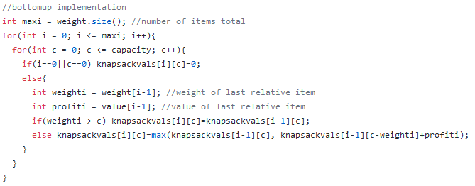
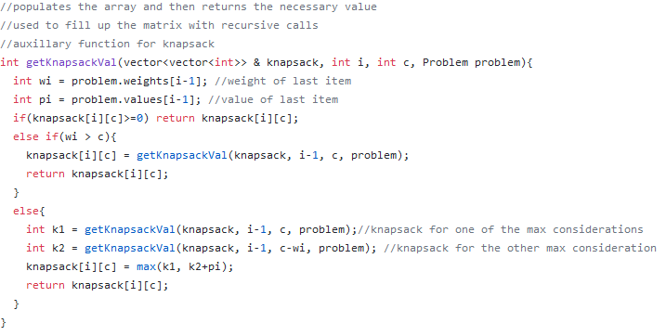
Implementation: Screenshots of the Code
Notes:
Larkin

Slide 12
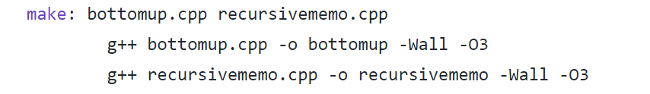
Implementation
Data structures:
Vectors
Structs
Programming Language:
Algorithms in C++
Compiled with -o3 optimization flag
Data Generation in python
Notes:
Larkin

Slide 13
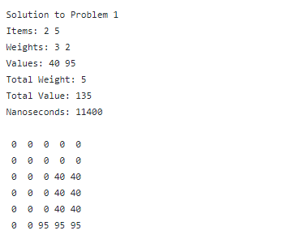
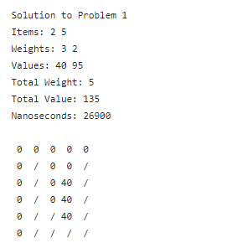
Demo
INPUT FORMAT
Line 1: Item Weights
Line 2: Item Values
Line3: Capacity
_____________________
7 3 5 3 2
98 40 20 20 95
5
Bottom-Up Output Recursive w/ Memo Output
Notes:
Larkin

Slide 14
Question & Experiments
Notes:
Nick

Slide 15
Problem Statement (Our Question)
Is one algorithm faster than the other in practice?
Significance of this Question:
Both algorithms have Θ (N * C) growth complexity, but experiment is needed to determine if one is better/faster than the other by a constant amount
Gives insight into which approach is better for specific situations
Opens discussion for flaws of each approach
Notes:
Nick

Slide 16
Demos & Experiments
How we designed our experiments:
Our dependent variable is algorithm runtime
In all experiments, we generated 50 different cases of N items with random weights in the range of 1 to (C + 2) and profit in the range of ($1 - $100). We then kept those generated items constant between both algorithms tested for that experiment.
Experiment #1 is our control group, where our constants are: N = 5, C = 5
Our independent variable in Experiments #2-3 is N, constant: C = 5
Our independent variable in Experiments #4-6 is C, constant: N = 5
Algorithms compared as: “faster is [((slower runtime/faster runtime)-1)*100]% faster than slower”
Notes:
Nick

Slide 17
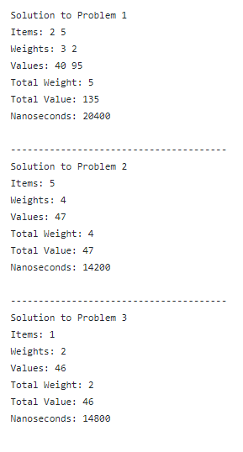
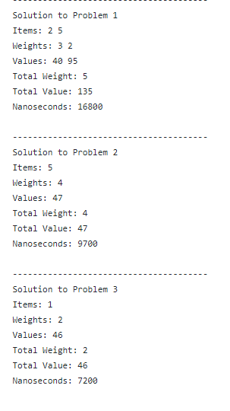
Experiment #1: Control Group
N = 5, C = 5
Demo:
INPUT FORMAT FOR EACH EXPERIMENT
Line 1: Item Weights
Line 2: Item Values
Line3: Capacity
_____________________
7 3 5 3 2
98 40 20 20 95
5
2 6 8 6 4
31 12 2 13 47
5
2 8 4 7 7
46 49 32 56 7
5
Bottom-Up Output Recursive w/ Memo Output
Notes:
Nick

Slide 18
Experiment #1: Control Group
N = 5, C = 5
Results:
Bottom-Up around 86% faster
Bottom-Up
Total Runtime: 283100 nanoseconds
Average Runtime: 5662 nanoseconds
Recursive w/Memo
Total Runtime: 526200 nanoseconds
Average Runtime: 10524 nanoseconds

Slide 19
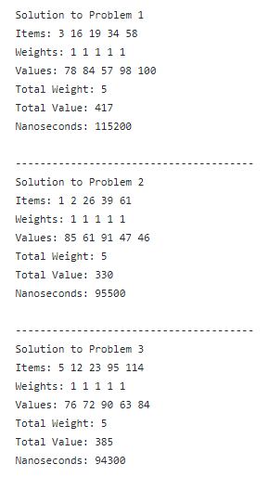
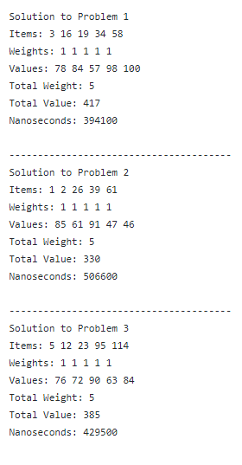
Experiment #2: Large N
N = 120, C = 5
Demo:
INPUT FORMAT FOR EACH EXPERIMENT
Line 1: Item Weights
Line 2: Item Values
Line3: Capacity
_____________________
8 8 1 7 4 ...
17 9 78 70 59 ...
5
1 1 2 5 7 ...
85 61 10 99 98 ...
5
6 7 5 4 1 ...
16 84 24 75 76 ...
5
Bottom-Up Output Recursive w/ Memo Output

Slide 20
Experiment #2: Large N
N = 120, C = 5
Results:
Bottom-Up around 393% faster
Bottom-Up
Total Runtime: 4131900 nanoseconds
Average Runtime: 82638 nanoseconds
Recursive w/Memo
Total Runtime: 20380100 nanoseconds
Average Runtime: 407602 nanoseconds

Slide 21
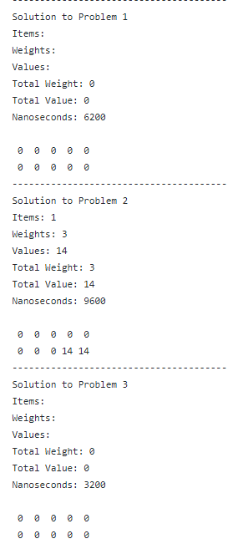
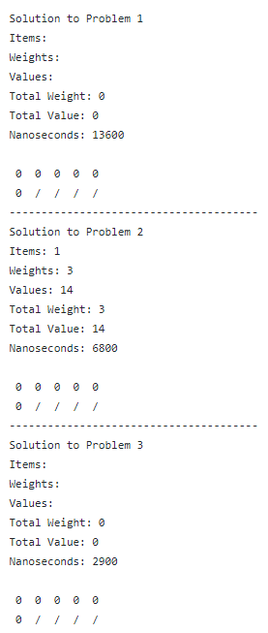
Experiment #3: Small N
N = 1, C = 5
Demo:
INPUT FORMAT FOR EACH EXPERIMENT
Line 1: Item Weights
Line 2: Item Values
Line3: Capacity
_____________________
8
39
5
3
14
5
7
33
5
Bottom-Up Output Recursive w/ Memo Output
Notes:
Nick

Slide 22
Experiment #3: Small N
N = 1, C = 5
Results:
Bottom-Up around 108% faster
Bottom-Up
Total Runtime: 119200 nanoseconds
Average Runtime: 2384 nanoseconds
Recursive w/Memo
Total Runtime: 247800 nanoseconds
Average Runtime: 4956 nanoseconds

Slide 23
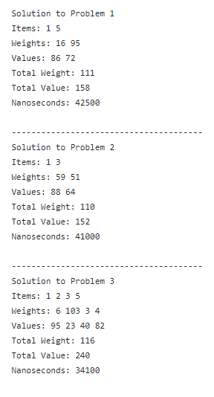
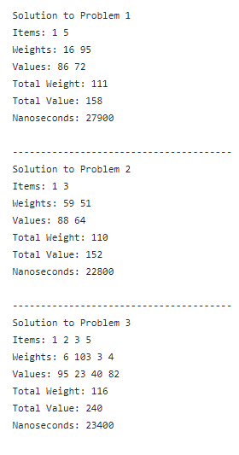
Experiment #4: Large C
N = 5, C = 120
Demo:
INPUT FORMAT FOR EACH EXPERIMENT
Line 1: Item Weights
Line 2: Item Values
Line3: Capacity
_____________________
16 118 122 59 95
86 7 62 33 72
120
59 52 51 101 44
88 2 64 41 39
120
6 103 3 65 4
95 23 40 16 82
120
Bottom-Up Output Recursive w/ Memo Output

Slide 24
Experiment #4: Large C
N = 5, C = 120
Results:
Bottom-Up around 14% faster
Bottom-Up
Total Runtime: 1917300 nanoseconds
Average Runtime: 38346 nanoseconds
Recursive w/Memo
Total Runtime: 1687600 nanoseconds
Average Runtime: 33752 nanoseconds

Slide 25
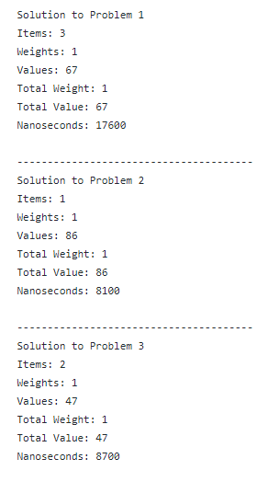
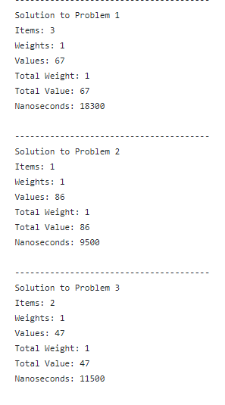
Experiment #5: Small C
N = 5, C = 1
Demo:
INPUT FORMAT FOR EACH EXPERIMENT
Line 1: Item Weights
Line 2: Item Values
Line3: Capacity
_____________________
2 2 1 3 4
27 79 67 11 51
1
1 2 2 4 2
86 10 63 63 76
1
4 1 4 4 2
64 47 3 49 59
1
Bottom-Up Output Recursive w/ Memo Output

Slide 26
Experiment #5: Small C
N = 5, C = 1
Results:
Bottom-Up around 25% faster
Bottom-Up
Total Runtime: 203800 nanoseconds
Average Runtime: 4076 nanoseconds
Recursive w/Memo
Total Runtime: 255200 nanoseconds
Average Runtime: 5104 nanoseconds

Slide 27
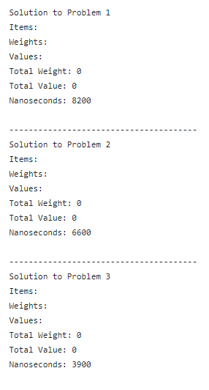
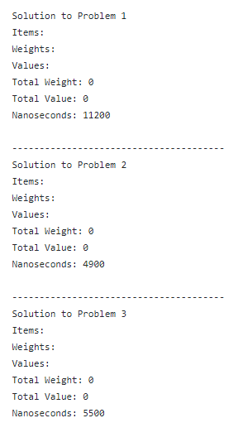
Experiment #6: No C
N = 5, C = 0
Demo:
INPUT FORMAT FOR EACH EXPERIMENT
Line 1: Item Weights
Line 2: Item Values
Line3: Capacity
_____________________
1 2 2 1 2
16 94 100 32 37
0
3 1 2 2 2
2 58 34 16 63
0
3 3 1 2 2
36 24 38 55 52
0
Bottom-Up Output Recursive w/ Memo Output

Slide 28
Experiment #6: No C
N = 5, C = 0
Results:
Recursive w/Memo around 3% faster
Bottom-Up
Total Runtime: 154500 nanoseconds
Average Runtime: 3090 nanoseconds
Recursive w/Memo
Total Runtime: 150100 nanoseconds
Average Runtime: 3002 nanoseconds
Notes:
Nick Pellegrino

Slide 29
Final Results & Key Takeaways
Notes:
Miguel

Slide 30
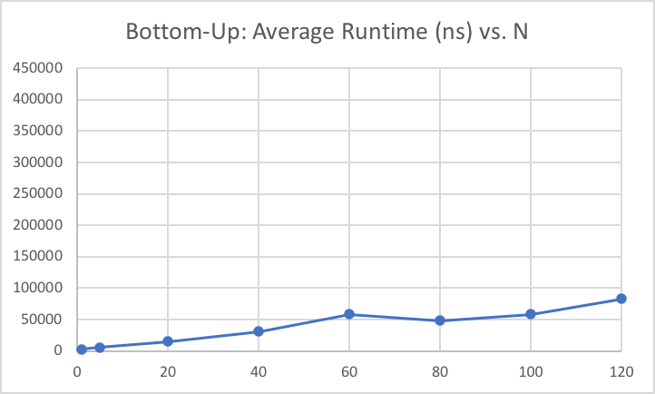
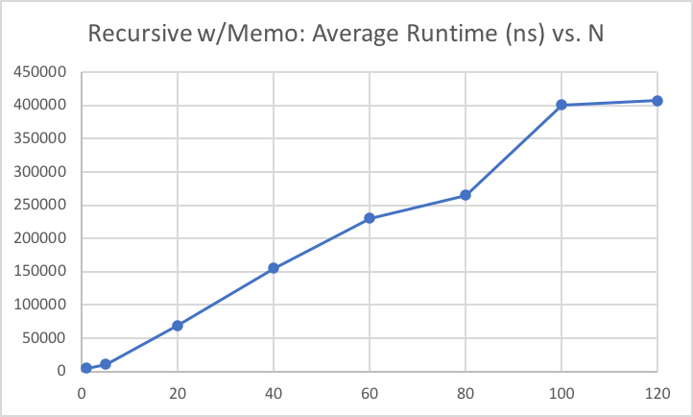
Final Results & Key Takeaways
Average Runtime (ns)
Average Runtime (ns)
N
N
Each bullet point represents 50 tests with C = 5 and N randomized items.
Notes:
Miguel

Slide 31
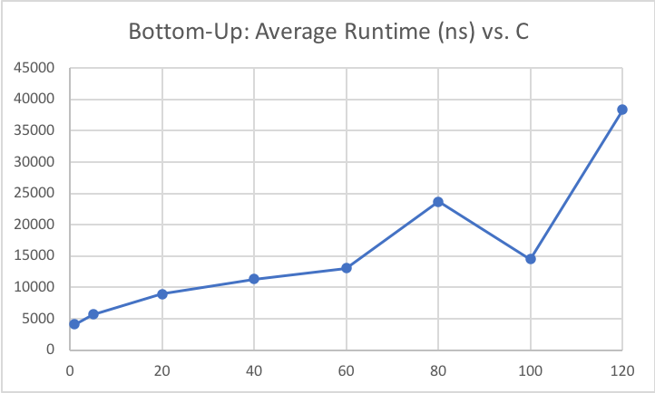
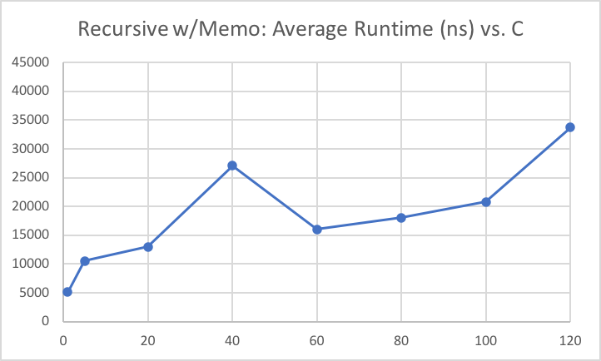
Final Results & Key Takeaways
Average Runtime (ns)
Average Runtime (ns)
C
C
Each bullet point represents 50 tests with varying C’s and 5 randomized items.
Notes:
Miguel

Slide 32
Key Takeaways From Results
Both algorithms have the same growth class, but different slopes
Bottom-Up is O(k*N*C)
Recursive-with-Memo is O(k’*N*C)
...with constants 0<k<k’
Recursive calls heavily influence runtime
Bottom-Up outperforms Recursive-with-Memo

Slide 33
Limitations and Future Works
More unique & varied experiments could improve our results
New situations (different Ns and Cs)
New constants (instead of always using N=5, C=5)
Focus on item weights/profits instead of randomizing them
More tests per experiment
Instead of just 50 tests per experiment
Testing different methods of storage & retrieval for memoization
Different types of hash maps/hash tables

Slide 34
Concluding Remarks
All group members contributed equally to the following:
Project Design
Programming
Algorithm implementation
Experiment design
Running experiments
Presentation creation
Notes:
Miguel

